Slide 1
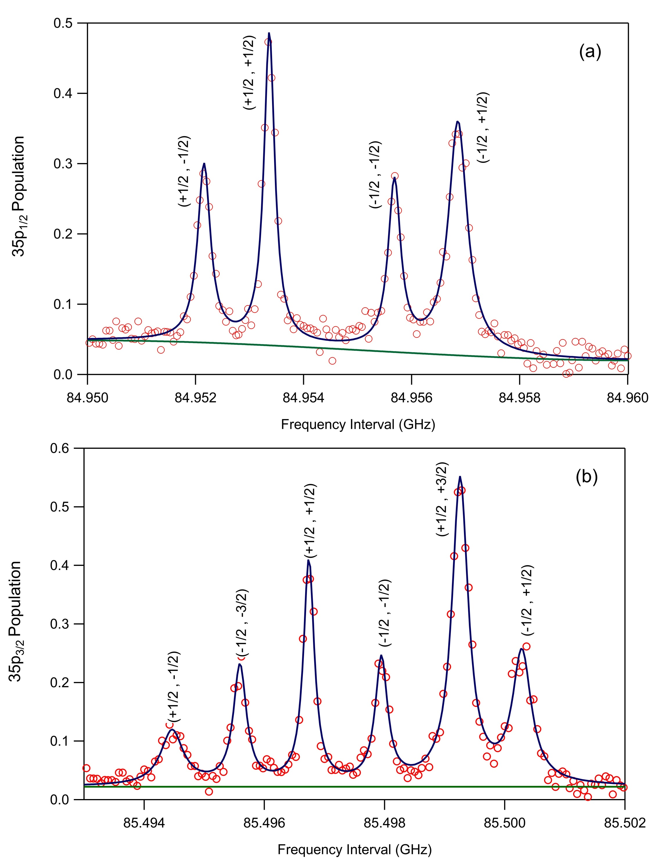
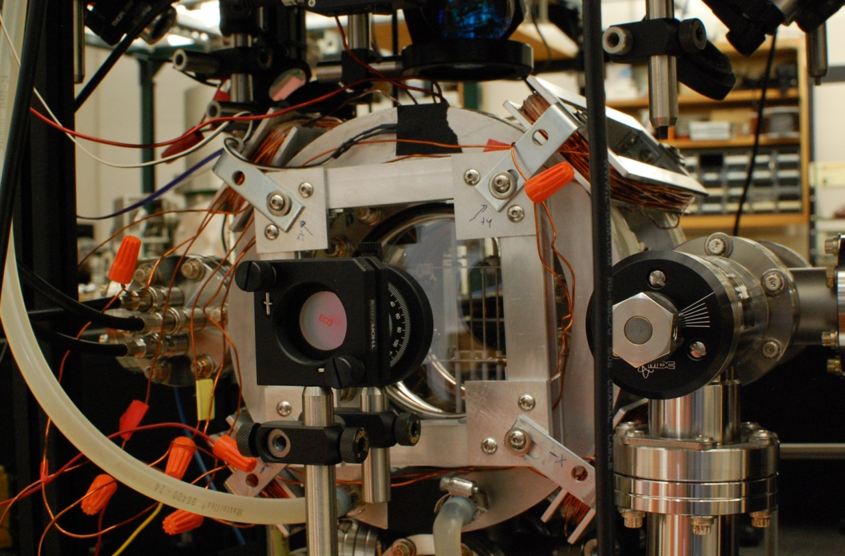
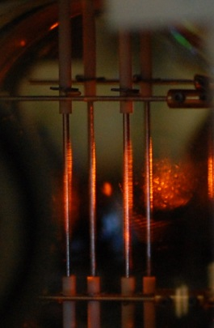
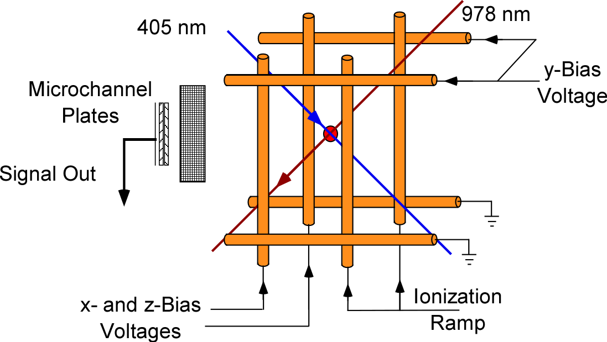
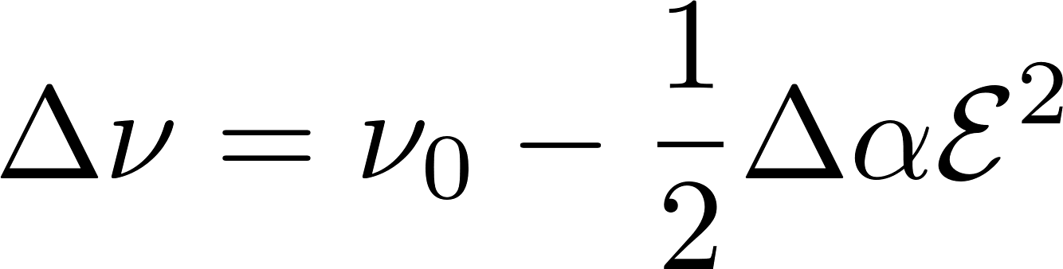
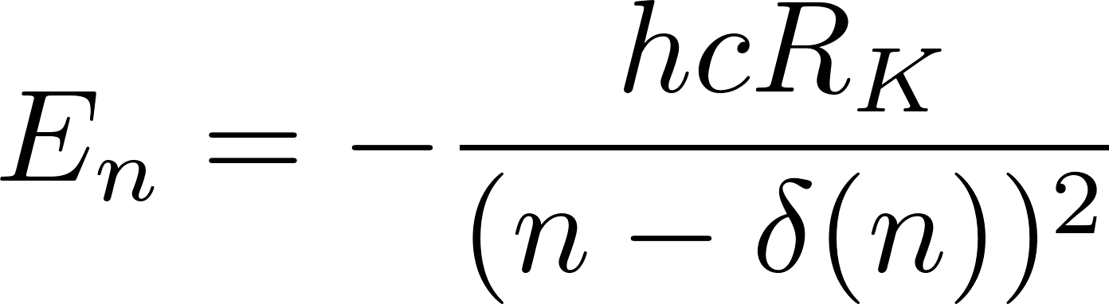
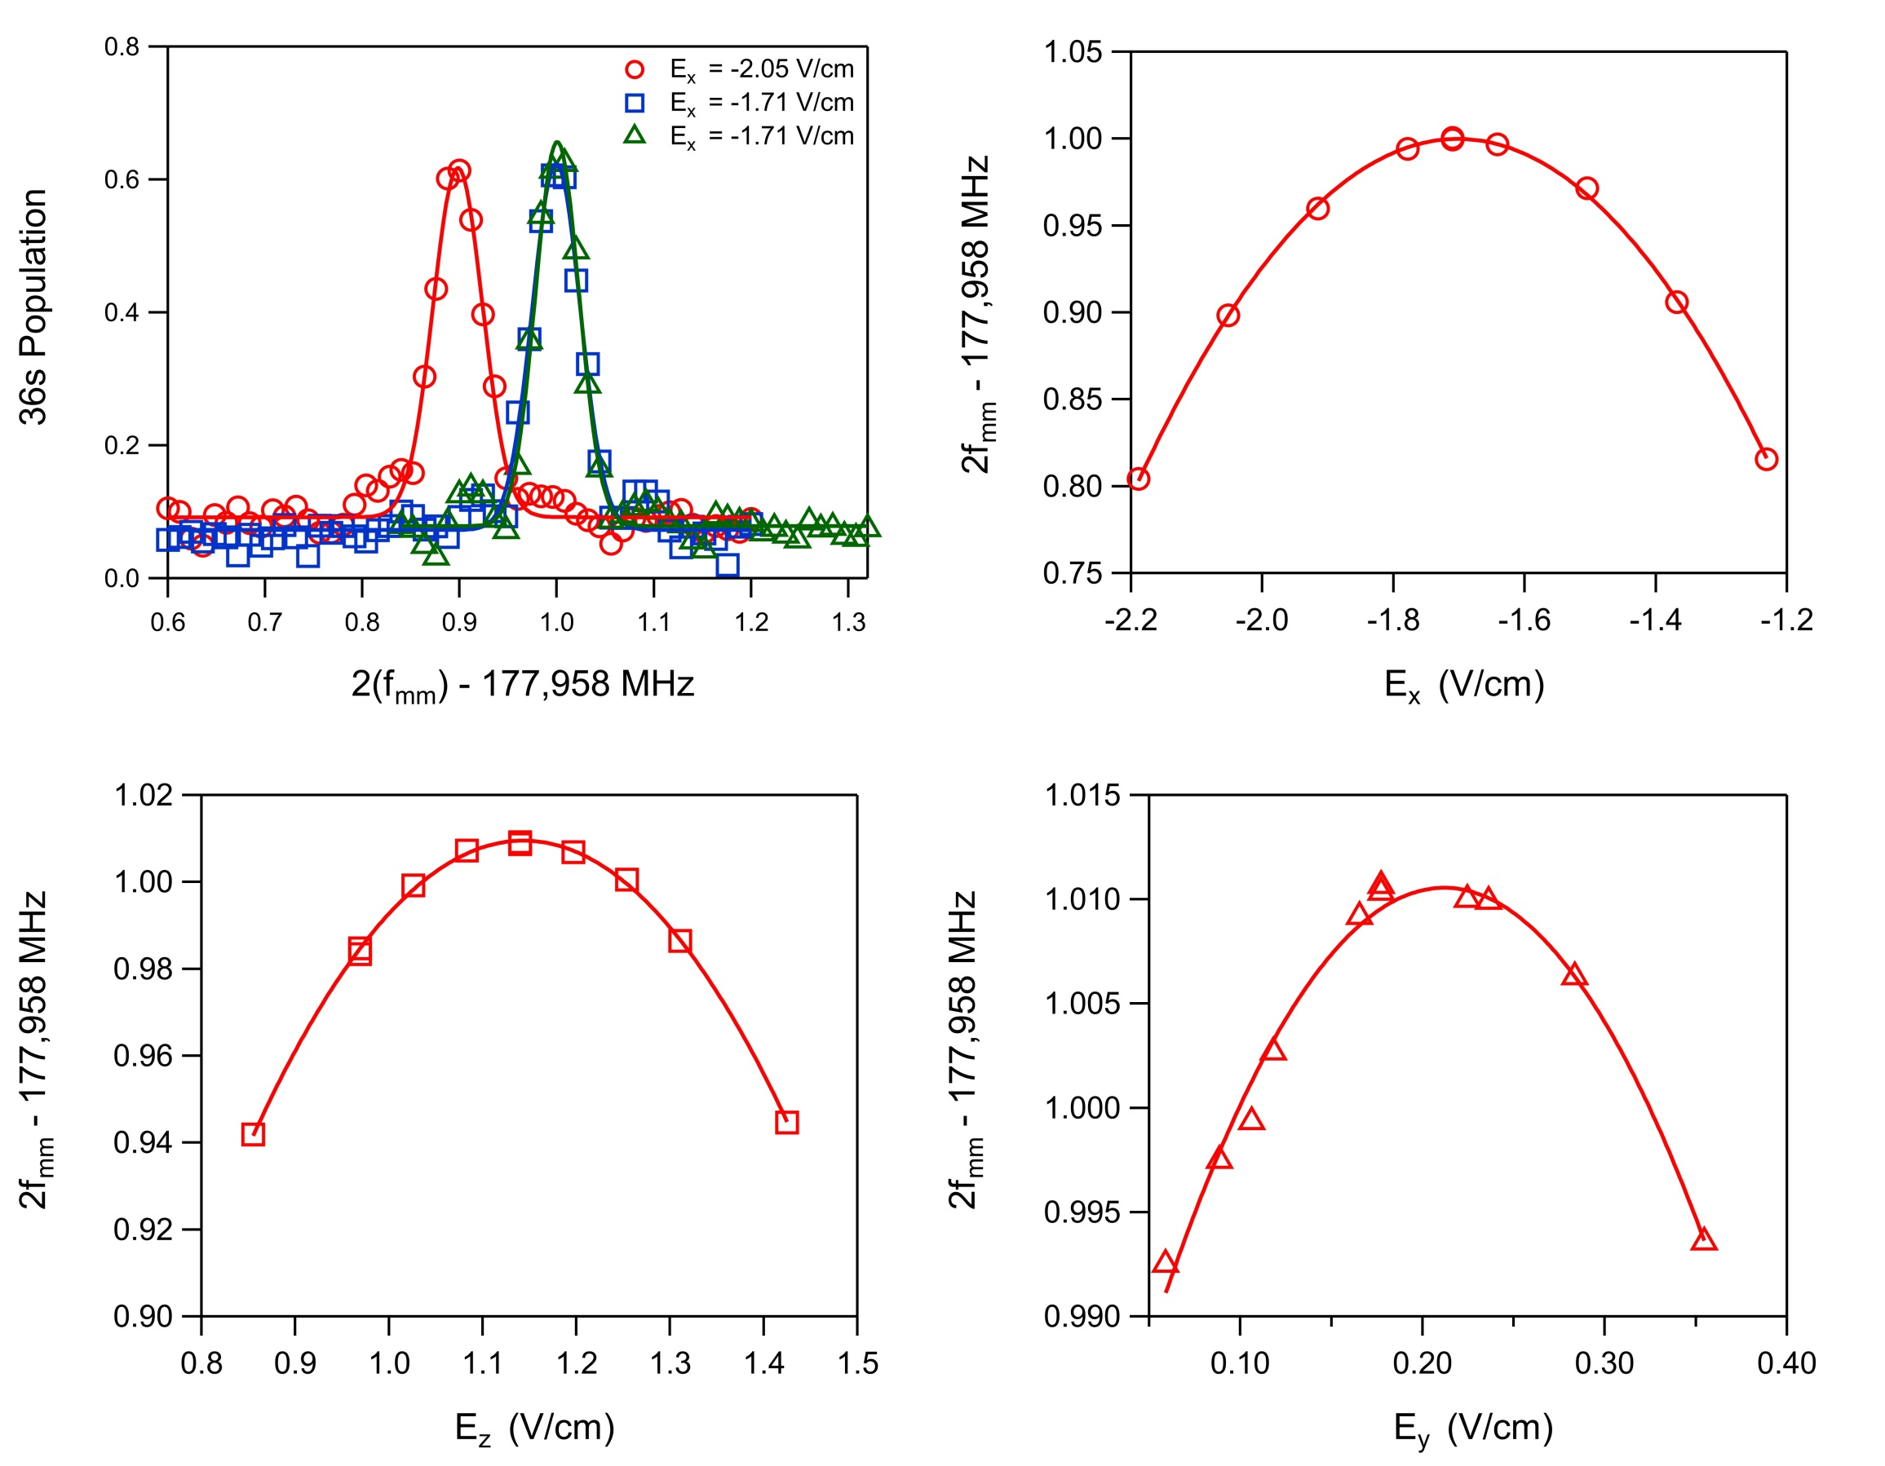
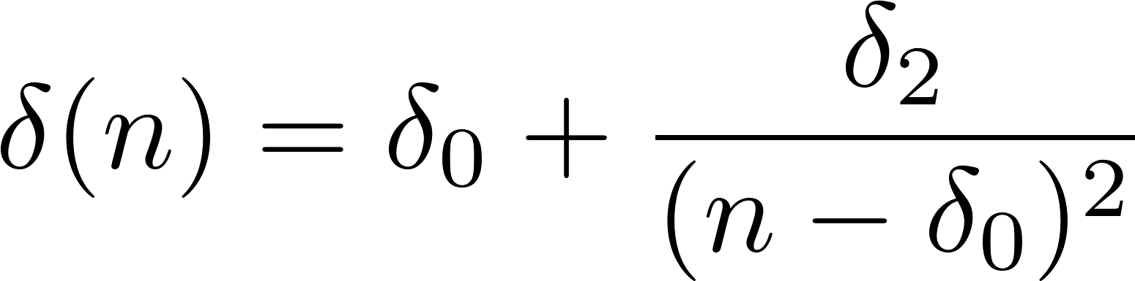
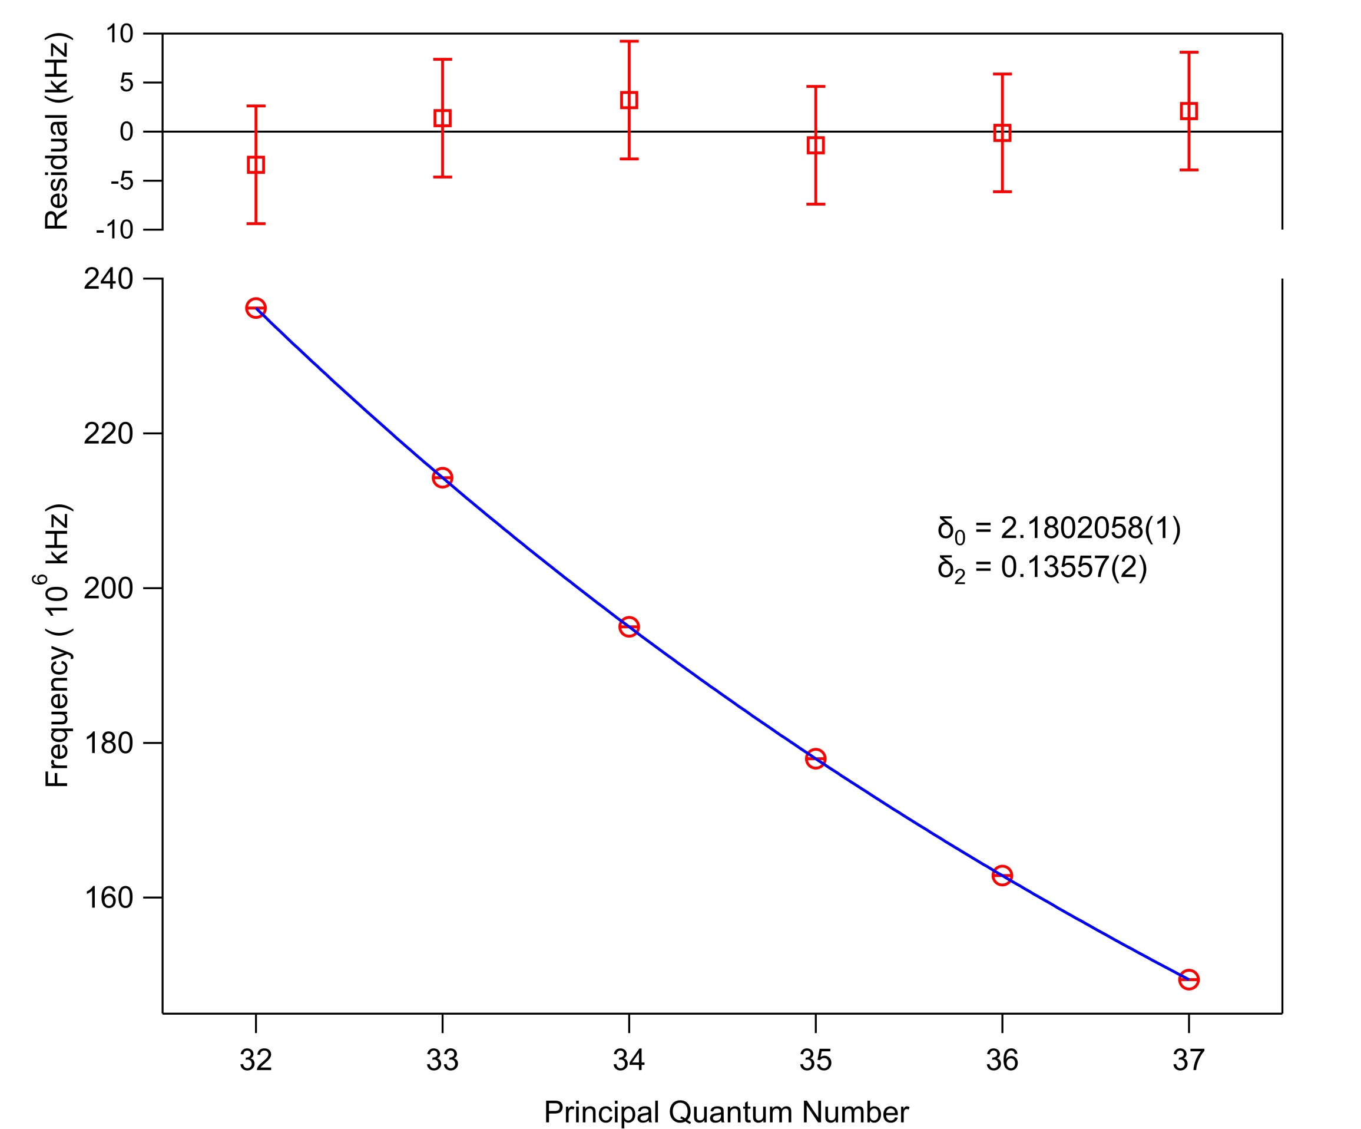
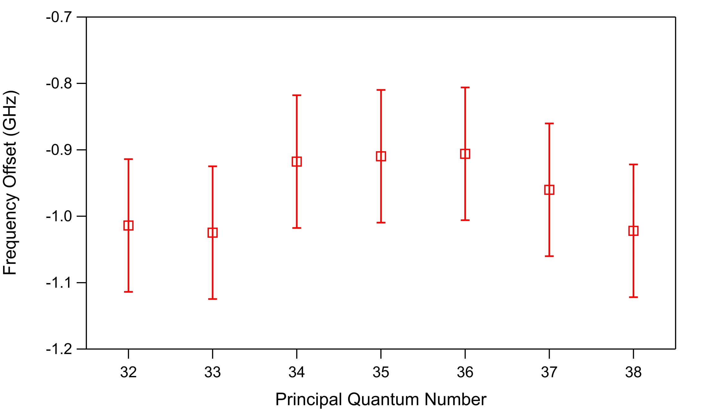
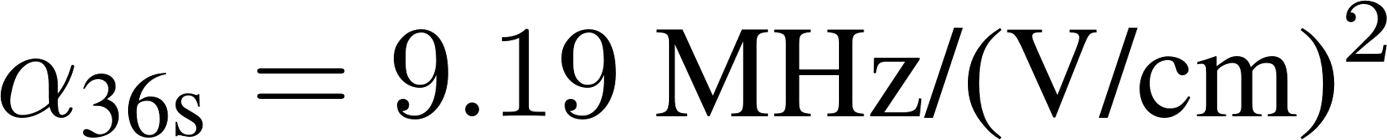
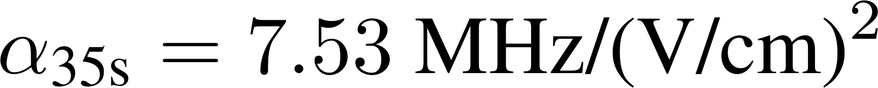
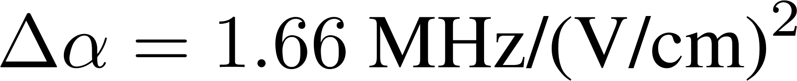
Millimeter-wave spectroscopy
of Rydberg states in Potassium
Charles Conover, Philip Adamson ’16, Gabriel Forest ’18, and Huan Bui ‘21 Colby College, Waterville, Maine
Observed 35s to 35p transitions
Abstract
We report high-precision measurements of millimeter-wave transitions between Rydberg states in potassium. We make measurements in a magneto-optical trap with a temperature of 1-2 mK and peak atomic density of 10⁹ atoms/cm³. The cold atoms are excited to Rydberg states in steps from 4s_{1/2} to 5p_{3/2} and from 5p_{3/2} to ns_{1/2} states using stabilized external-cavity diode lasers at 405 nm and 980 nm. Millimeter-wave transitions are detected by selective field ionization. We null stray electric fields in three dimensions using potentials applied to a set of mutually perpendicular rods surrounding the MOT cloud. The measured frequency intervals are measured to better than a part in 10⁷ and are then used to determine the quantum defects and absolute energies of the Rydberg states.
Photograph of the MOT, with the inset photo showing the MOT cloud centered between eight rods that can be used to apply static and ramped electric fields to selectively field ionize the atoms. Millimeter waves are introduced using a horn outside the vacuum chamber.
Schematic diagram of the Rydberg setup showing the paths of the Rydberg excitation lasers, the arrangement of the rods used to apply fields, and the charged particle detector.
Effect of Static Electric Fields
Determination of s-state quantum defects
Rydberg state energies are very sensitive to the static electric field. The measured ns to (n+1)s transition frequency versus static field is
With the Rydberg state energies
where Δα is the difference between the (n+1)s and ns scalar polarizabilities.
and using the parameterization
Spectra of the (a) 35s to 35p_{1/2} and (b) 35s to 35p_{3/2} transitions measured in the MOT. The mm-wave pulse width was 4 μs; the lines are close to transform limited. Hyperfine structure is not resolved and the spacings between the transitions are due to a 1.25 G magnetic field.
a fit of the measured transition frequencies can be used to determine the quantum defect parameters δ₀ and δ₂.
Re-evaluation of the 5p_{3/2} energy
Energy levels and appropriate transitions for the cooling and trapping and two-color excitation of Rydberg states in potassium.
We find a systematic offset between the measured 5p_{3/2} to ns_{1/2} transition frequencies and those calculated based on the determined energies of the ns_{1/2} states and the NIST tabulated 5p_{3/2} energy.
Observed spectra, and peak location versus the static field in three orthogonal directions. The maximum frequency is measured when the component of the field is nulled to zero.
For the 35s to 36s transition shown we calculate
Measured ns to (n+1)s transition frequencies versus principal quantum number. The fit has residuals that are smaller than 5 x 10⁻⁸ of the transition frequency.
The measured offset is roughly six times the uncertainty reported in the NIST tables.
Millimeter-wave transitions and their approximate frequencies
in good agreement with the experimental measurements.
Acknowledgements
The research was supported by Colby College and the National Science Foundation.

